Slide 1
Case 7: AW Dr. Sekkath-Veedu
69 year old female
Diagnosis: Adenocarcinoma with mucinous features of the lower lobe of the lung (Stage IIB)
Other Clinical Information:
Performance Status: 1
Hepatic Function: No recent labs in EPIC
Renal Function: No recent labs in EPIC
Family History: No relevant family history
Comorbidities: Ocular myasthenia gravis, GERD, HTN, HLD, diastolic CHF, and Afib on apixaban
Oncology History:
Planned surgical resection followed by adjuvant chemotherapy
Molecular Testing:
Specimen Site: lower lobe of the lung; Collected: 4/2025; Panel: Caris; Dated: 5/2025

Slide 2
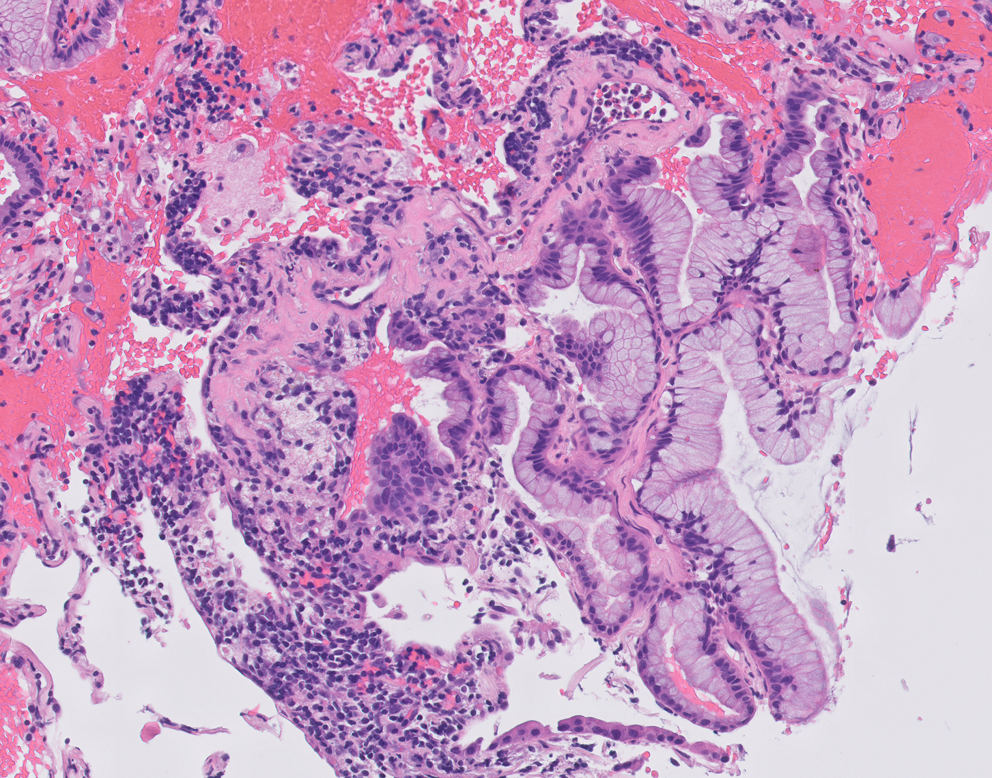
Case 7
Right lower lobe of the lung: mucinous adenocarcinoma

Slide 3
Case 7 Prior: none Caris Current: adjuvant chemo (planned post-op) Dx: lung adenocarcinoma
Alteration | Function | Oncogenic | On-label | Clinical Trial | Off-label (Evidence level) | Allele frequency (%)
MET | Receptor tyrosine kinase; PI3K/MEK pathways | 35%, 3+ | None | NCT04270591 (Ph 1b/2) NCT03175224 (Ph 1/2) NCT04693468 (Ph 1b) NCT06083857 (Ph 1/2) | Telisotuzumab vedotin (2L+) | n/a
KRAS G12D | GTPase ; MAPK signaling | Yes, gain | None | NCT06586515 (1a/b) NCT05382559 (Ph 1) NCT06040541 (Ph 1/1b) NCT05585320 (Ph 1/2a) NCT06385925 (Ph 1/2) | None | 18
CDH1 D400N | E-cadherin; cell adhesion | Unknown | None | None | None | 13
LOH | Loss of heterozygosity | 2%, low | None | None | None | n/a
TMB | Measures mutation/Mb DNA | 2, low | None | None | None | n/a
MSI | Measures hypermutability | Stable | None | None | None | n/a
PD-L1 | Measures response to immunotherapy | TPS 0% | None | None | None | n/a
Notes:
Stage IIb
CHF, afib on Eliquis, myasthenia gravis
NFE2L2 Y576H VUS
HER2 negative 1+
MET
NCT04270591 (Ph 1b/2): glumetinib (selective METi), NSCLC w/ Met alterations (Met amp GCN >4, MET IHC 2+), closest in Louisville (preliminary, 4 MET overexpressed NSCL (1 PR, 3 SD)
NCT03175224 (Ph 1/2): APL-101 (cMETi), Cohort F (MET overexpression, unknown cutoff), closest in SCRI or Ohio State
NCT04693468 (Ph 1b): Talazoparib + Crizotinib, Arm C (MET defects, unknown cutoff), only MDACC
NCT06083857 (Ph 1/2): amivantamab + tepotinib, MET skipping, amp, overexpression IHC 3+, MDACC only
KRAS
NCT06586515 (1a/b): LY3962673 (GDP-bound KRAS G12Di) +/- chemo or cetux, KRAS G12D solid tumors, SCRI, Cincy, Indianapolis
NCT05382559 (Ph 1): ASP3082 (KRAS G12D PROTAC-degrader) +/- cetuximab, KRAS G12D solid tumors, SCRI or Cleveland
NCT06040541 (Ph 1/1b): RMC-9805 (RAS-ONi), KRAS G12D solid tumors, SCRI or Cincy
NCT05585320 (Ph 1/2a): IMM-1-104 (MEK 1/2i), pan-KRAS, SCRI
NCT06385925 (Ph 1/2): TSN1611 (KRAS G12Di), KRAS G12D solid tumors including nsclc, closest in Fairfax VA

